Slide 1

Presentation by
Python
Week 6
Sarfraz Brohi
CSCT
November, 2023

Slide 2
Today in POP…
What is Python?
What is it used for and why is it popular?
The philosophy of Python
The Python language:
Comments
Blocks
Variables
Control Structures (decisions and loops)
Arrays
File i/o
Functions

Slide 3
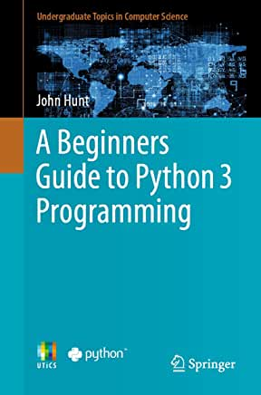
Learning Python
W3Schools Tutorial:
https://www.w3schools.com/python/

Slide 4
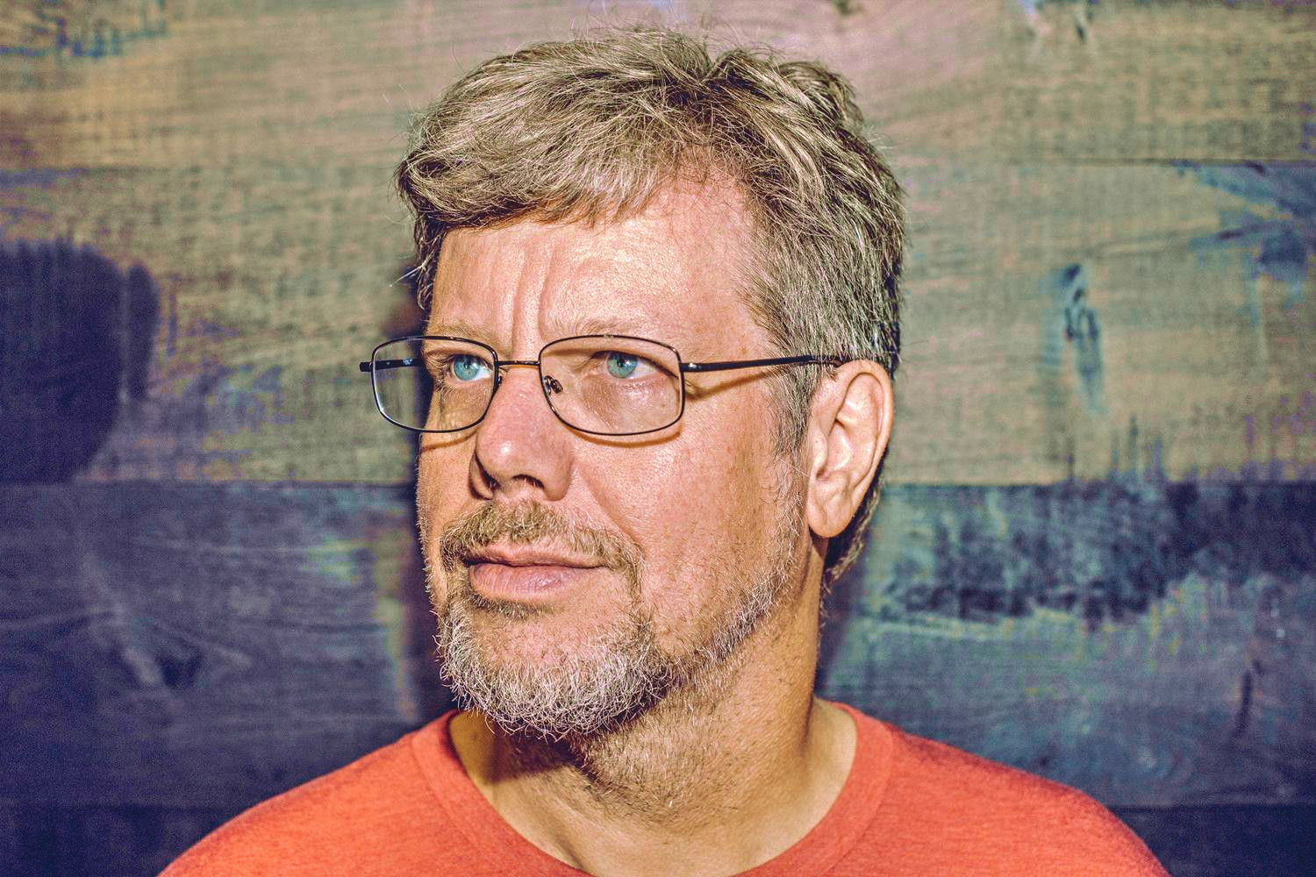
Quick History
Developed in the early 1990s by Guido van Rossum
Name after Monty Python’s Flying Circus
Objectives:
An easy and intuitive language just as powerful as major competitors
Open source, so anyone can contribute to its development
Code that is as understandable as plain English
Suitability for everyday tasks, allowing for short development times

Slide 5

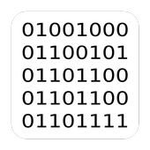

Compiled vs Interpreted
#include <stdio.h>
int main() {
int score;
printf("Enter score: ");
scanf("%d", &score);
if (score >= 70) printf("A\n");
else if (score >= 60) printf("B\n");
else if (score >= 50) printf("C\n");
else if (score >= 40) printf("D\n");
else printf("F\n");
return 0;
}
Compiler
Machine Code
Source Code
Interpreter
score = int (input ("Enter Score: "))
if score >=70:
print("A")
elif score >=60:
print("B")
elif score >=50:
print("C")
elif score >=40:
print("D")
else :
print ("F")
Source Code

Slide 6
Compiled vs Interpreted
Compiled (e.g. C) | Interpreted (e.g. Python)
Distribute machine code | Distribute source code
Standalone programs | Need an interpreter to run
OS dependent | Platform independent
Usually faster | Usually slower
Recompile to see changes | Changes quick on the fly

Slide 7
What is Python?
Interpreted language
Platform independent
Mixed paradigm
Procedural (imperative)
Object oriented
Functional
Dynamic Typing
Designed to be a simple, forgiving language

Slide 8
Common Uses
Web development (mostly backend)
Rapid development / prototyping (GUI libraries)
Database access
AI (libraries such as Scikit-Learn or TensorFlow)
Data Science and FinTech
Embedded systems
Mobile Apps
The “go to” language of CS research

Slide 9
The Philosophy of Python
Simple code
Human readable code
Readable style is enforced by the syntax (indentation)
One statement per line
The Zen of Python Easter Egg : “import this”

Slide 10
Python is simple
English like syntax
No braces, or semi-colons
Blocks indicated by indentation
One statement per line
No pointers
Only ever a single error
Interpreter immediately halts on error

Slide 11
Versions of Python
Python 2 vs Python 3
2.0 (2000) – 2.7.18 (2020) - discontinued
3.0 (2008) – 3.12.0 (2023)
Available for Windows from www.python.org
Python 2 is always included with Mac and Linux
Python 3 for Mac and Linux can be obtained from www.python.org

Slide 12
Beware!
Python 2 vs Python 3 are not source compatible
Python 2
print ”Hello World!”
Python 3
print (”Hello World!”)

Slide 13
Python Editors
Visual Studio Code
Idle – development environment included with Python
PyCharm
Thonny (Python IDE for beginners)
Many, many more

Slide 14
Python shell, variables and operators
Shell can be used to test statements
Dynamic typing
Arithmetic and Logical operators similar to C See: https://www.w3schools.com/python/python_operators.asp
Shell demonstration

Slide 15
Comments, input() and print()
Comments are preceded by #
input() reads user data from console
print() outputs text to console (lots of formatting options)
demo.py

Slide 16
Blocks and decisions
No braces in Python – indentation is used to delimit blocks
Booleans are True or False (NB case sensitive)
Decisions made by if / elif / else
No switch statement
Examples: DisplayGrade.py
ChineseZodiac.py

Slide 17
Loops
While loops work similarly to C
For loops are quite different
Examples: demo2.py
MultiplicationTable.py

Slide 18
Arrays
Simple array-like functionality built into Python (list)
Much more sophisticated arrays in the numpy library
Example: demo3.py
AnalyseNumbers.py

Slide 19
File i/o
Similar to C
Methods of opening a file
“r” – read
“a” – append
“w” – write
“x” – create
Type of file
“t” – text
“b” – binary
Examples: DisplayFile.py

Slide 20
Functions
Similar to C
Blocks of code defined by def
Arguments and return values similar to C
Examples: demo4.py

Slide 21
Summary
Python is flexible and widely used in CS
Python is much easier than C
Many powerful libraries
Language basics (comments, blocks, variables, control Structures, arrays, file i/o and functions).
Many of the C examples have been converted to Python

Slide 22
To do before the next lecture
Make sure you can run Python programs
Look through the examples and make sure you understand them
Check out the W3Schools tutorial
Get the John Hunt book from the library
Attend the labs!

